Slide 1
Semester 2 Project Plan
Florida Tech History Tours

Slide 2
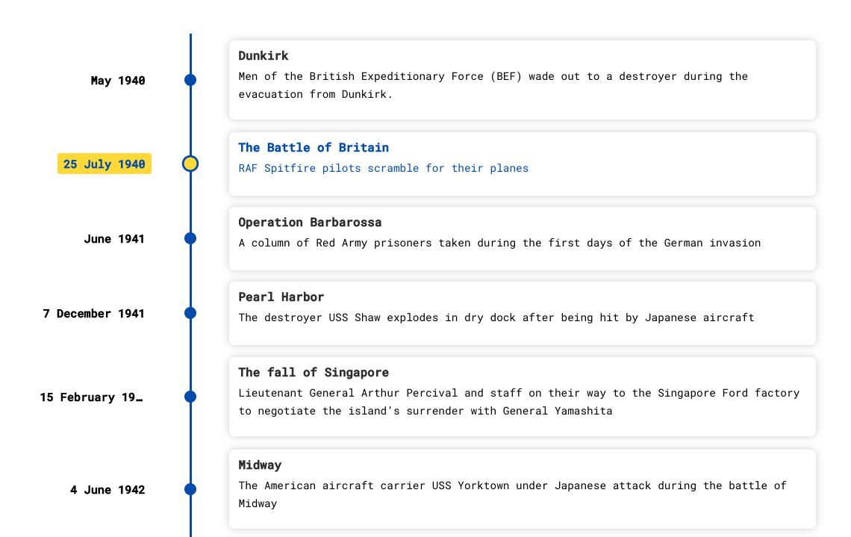
Algorithms and Tools/Integrations

Slide 3
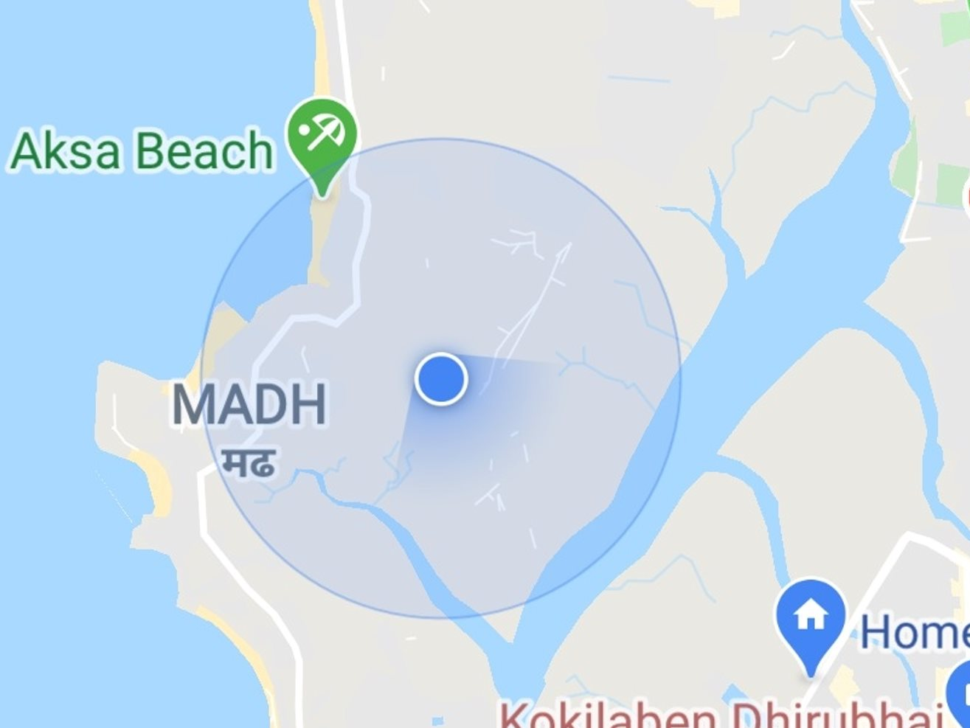
Technical Challenges
GPS Inaccuracies
Timeline Data Streaming

Slide 4
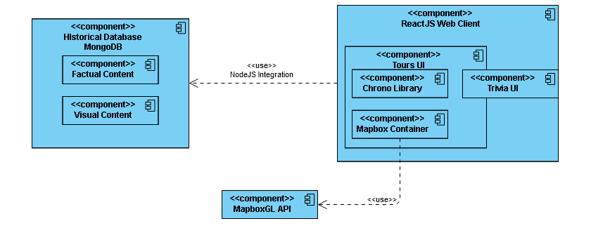
Design of the System

Slide 5
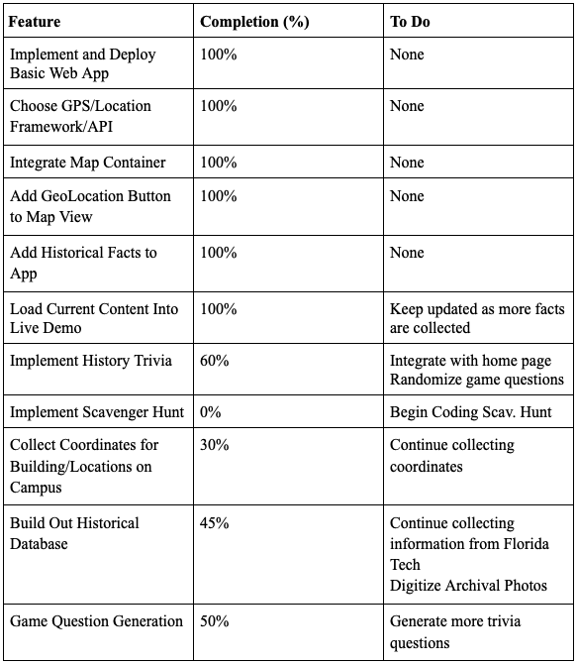
Progress Summary

Slide 6
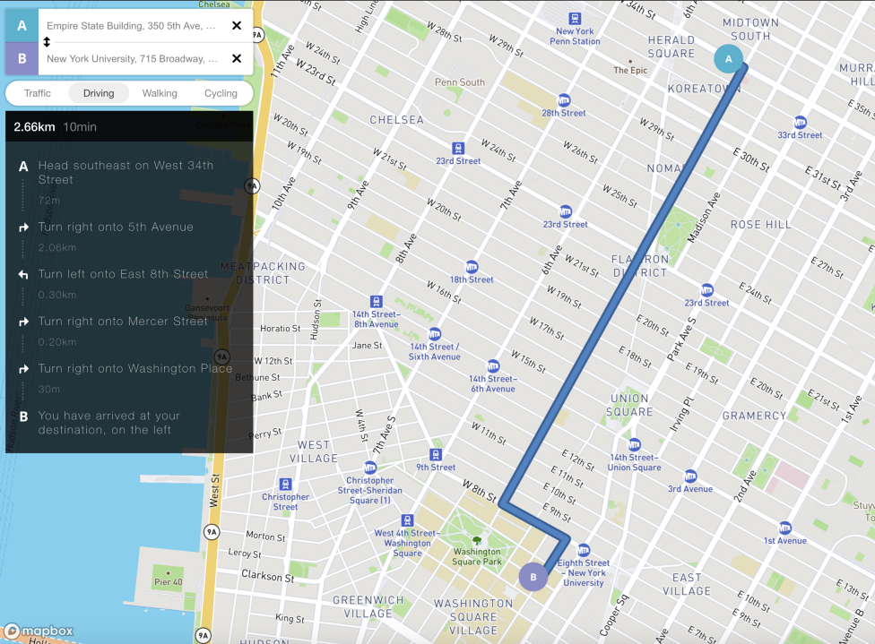
Milestone #4
Implement initial tour paths for guided navigation
Design and Integrate Layouts for the Points of Interest across campus
Begin Implementation of the additional game(s), e.g. scavenger hunt, name game, etc.
Create Geofences with latitude and longitude values for campus buildings

Slide 7
Milestone #5
Create full campus tours for the various routes
Design and implement settings menu for application settings and social media sharing
Begin evaluation of the system for final analysis / senior design poster

Slide 8
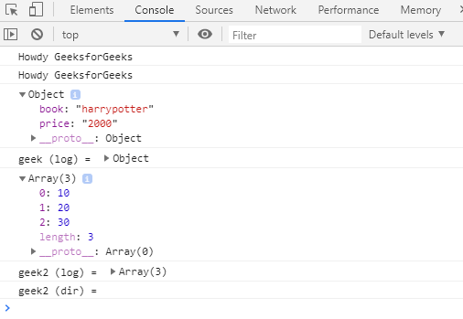
Milestone #6
Clean up the UI and add in debug options for location and other resources
Create user/developer manual
Create demo video

Slide 9
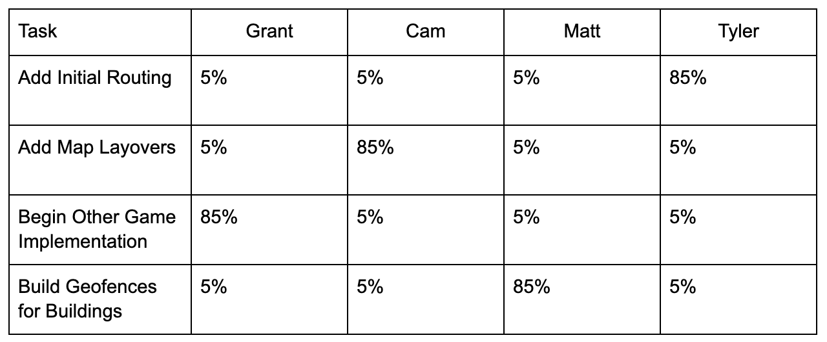
Next Milestone Matrix

Slide 10
Questions?

